Slide 1
Towards upgrading CoalHMM, or the inconvenience of having a state-space explosion and trying to overcome it

Slide 2
Outline
The coalescent with recombination
The state-space model
Time discretization
An HMM for rho and theta
Moving towards ILS

Slide 3
The coalescent with recombination
Two loci: different coalescent times (tree heights) if unlinked by recombination.
Mutations are distributed depending on the tree height.
We can learn about ρ through mutations

Slide 4
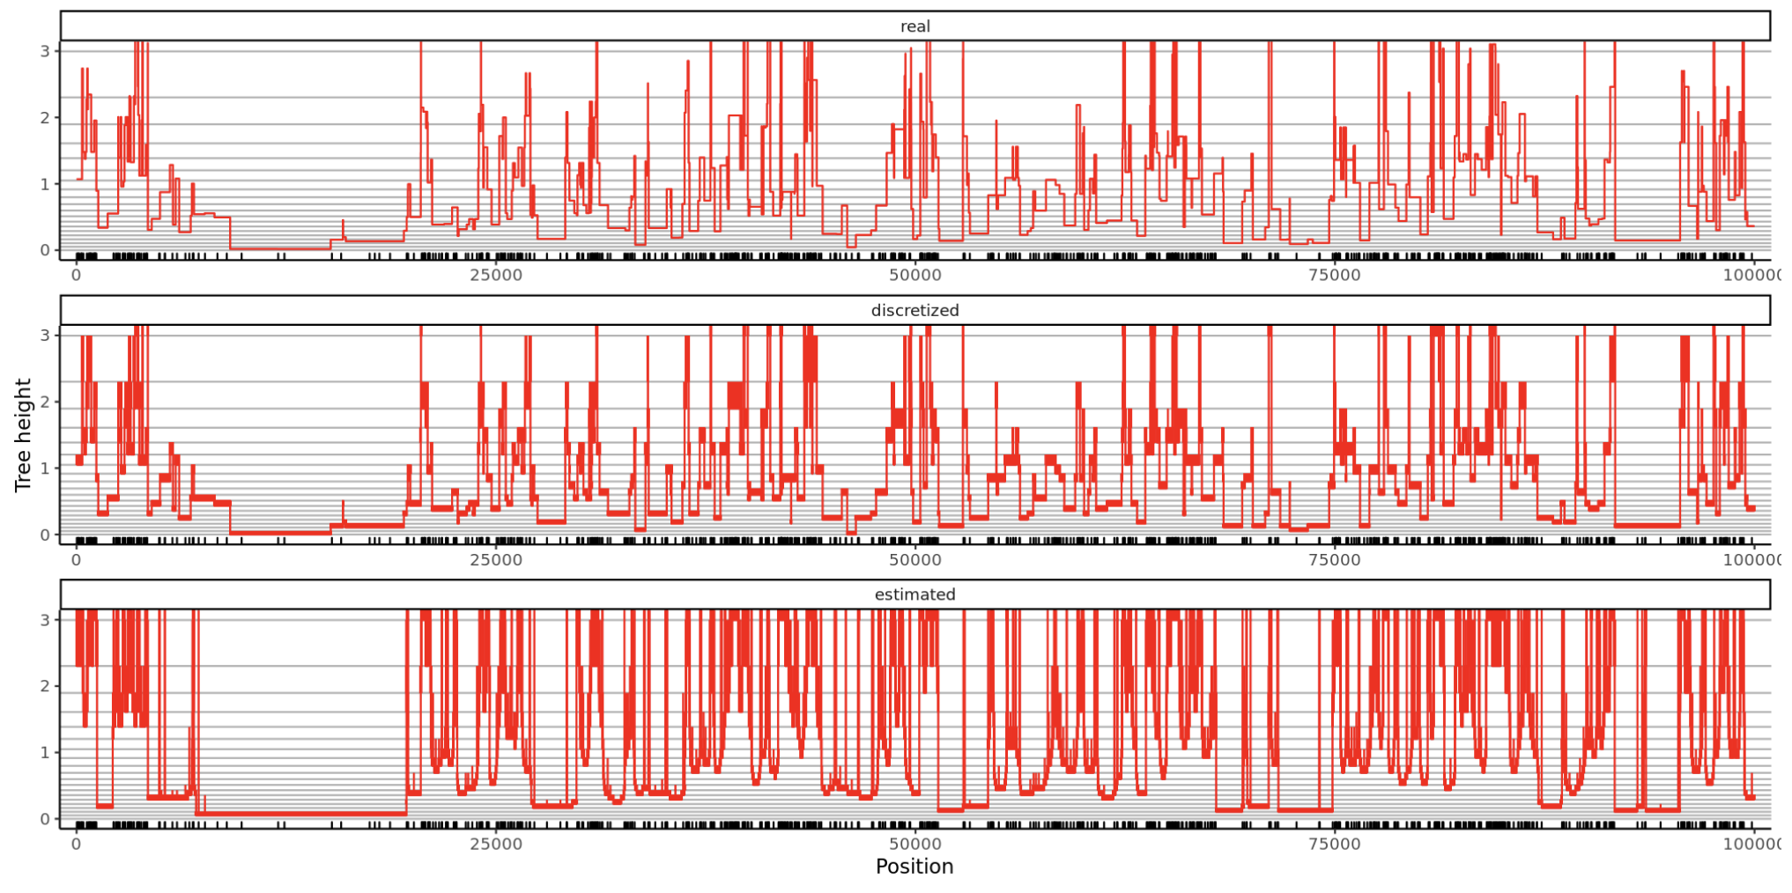
The coalescent with recombination
Two loci: different coalescent times (tree heights) if unlinked by recombination.
Mutations are distributed depending on the tree height.
We can learn about ρ through mutations
Tree heights along an msprime simulation of 100 kb, with $ρ=0.01$ and $θ=0.02$

Slide 5
The state space model
Recombination event
Coalescence event

Slide 6
The state space model
Same tree height
③
Left tree taller
Right tree taller
4
ρ/2
1
②
1
1
1
1
ρ
⑥
④
⑤
⑦
Recombination event
Coalescence event
ρ/2
①
ρ/2
2
2
1
1
1
1
1
Adapted from Simonsen & Churchill (1997) and Wakeley (2009)
Absorbing
⑧

Slide 7
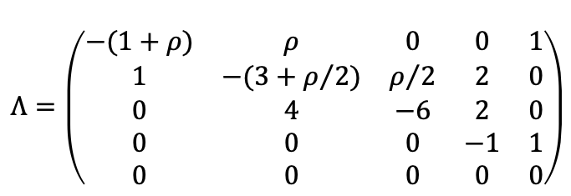
The state space model
Same tree height
③
4
ρ/2
2
Symmetry of the state space: simplification.
Transition rate matrix:
Different tree height
②
2
④
$$Λ=\left(\begin{matrix}−(1+ρ) & ρ & 0 & 0 & 1 \\ 1 & −(3+ρ/2) & ρ/2 & 2 & 0 \\ 0 & 4 & −6 & 2 & 0 \\ 0 & 0 & 0 & −1 & 1 \\ 0 & 0 & 0 & 0 & 0\end{matrix}\right)$$
1
ρ
①
1
Infeasible in continuous time:
Discretization of the times
1
Absorbing
⑤

Slide 8
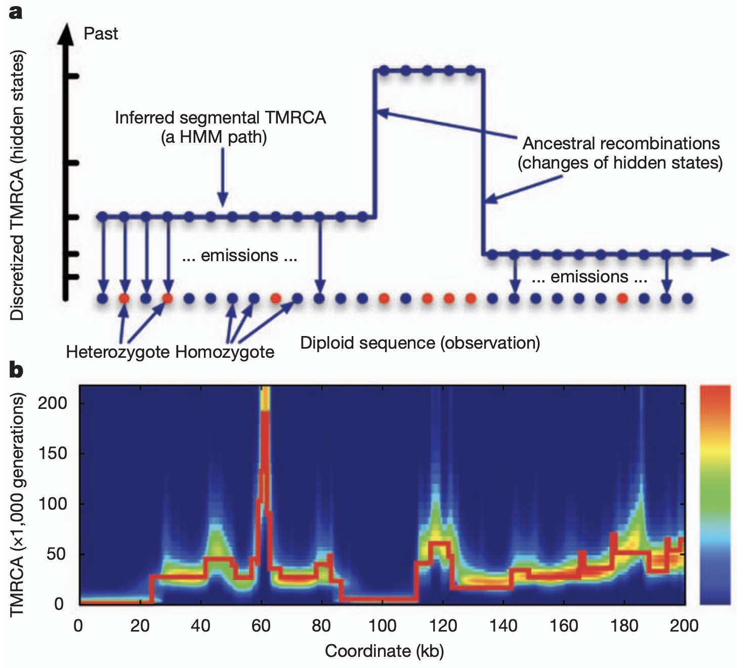
Time discretization
Divide tree heights in discrete intervals (PSMC-style).
Li & Durbin (2011)

Slide 9
Time discretization
Divide tree heights in discrete intervals (PSMC-style).

Slide 10
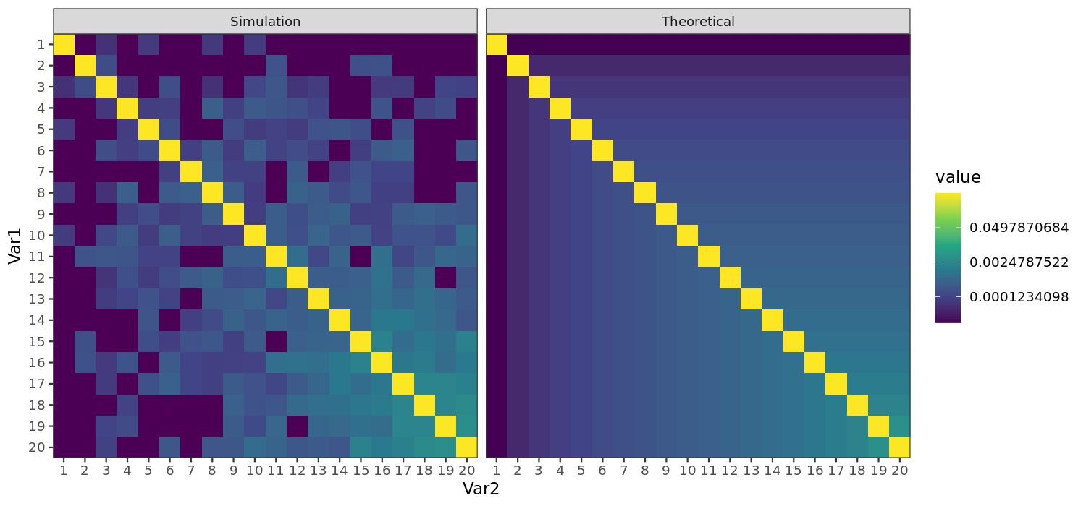
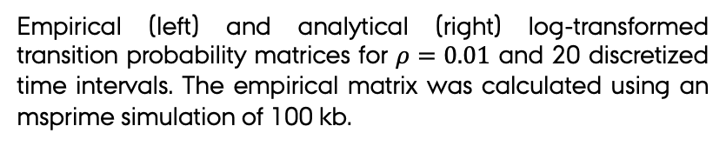
Time discretization
Divide tree heights in discrete intervals (PSMC-style).
Transform the rate matrix into a transition probability matrix:
Analytically.
Empirically from msprime.
Empirical (left) and analytical (right) log-transformed transition probability matrices for $ρ=0.01$ and 20 discretized time intervals. The empirical matrix was calculated using an msprime simulation of 100 kb.

Slide 11
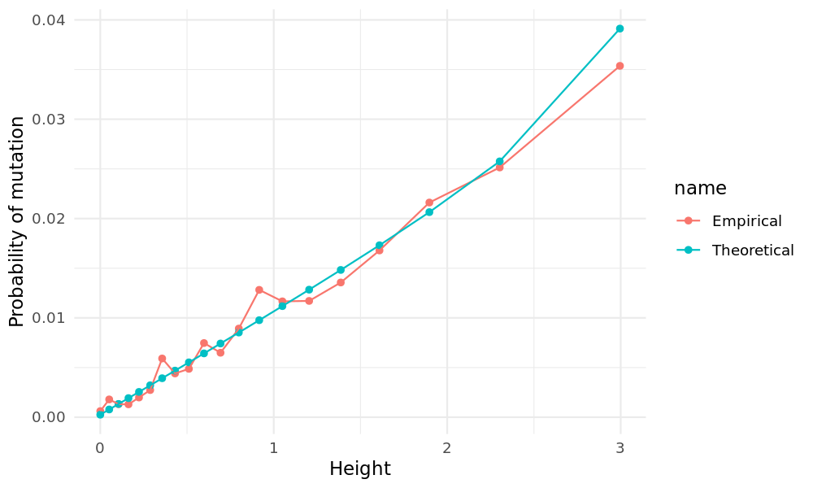
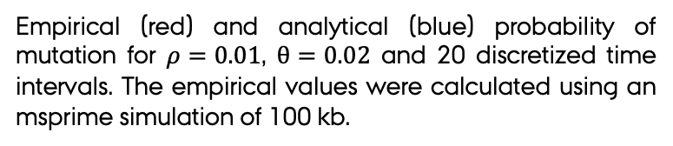
The mutational process
Divide tree heights in discrete intervals (PSMC-style).
Transform the probability of mutation given a tree height into the probability of mutation conditional on the discretized tree height.
Empirical (red) and analytical (blue) probability of mutation for $ρ=0.01$, $θ=0.02$ and 20 discretized time intervals. The empirical values were calculated using an msprime simulation of 100 kb.

Slide 12
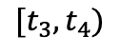
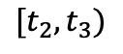
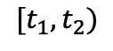
Hidden Markov model
$$[t_{3}, t_{4})$$
$$[t_{2}, t_{3})$$
$$[t_{1}, t_{2})$$
We can learn about rho and theta using a HMM:
Hidden states: discretized tree heights.
Observations: mutations.
Transition: discretized transition probability matrix.
Emission: discretized probabilities of mutation.
Initial probabilities: equal.

Slide 13
Hidden Markov model
$$[t_{3}, t_{4})$$
$$[t_{2}, t_{3})$$
$$[t_{1}, t_{2})$$
We can learn about rho and theta using a HMM:
Hidden states: discretized tree heights.
Observations: mutations.
Transition: discretized transition probability matrix.
Emission: discretized probabilities of mutation.
Initial probabilities: equal.
Use a forward algorithm to optimize the likelihood on theta and rho.

Slide 14
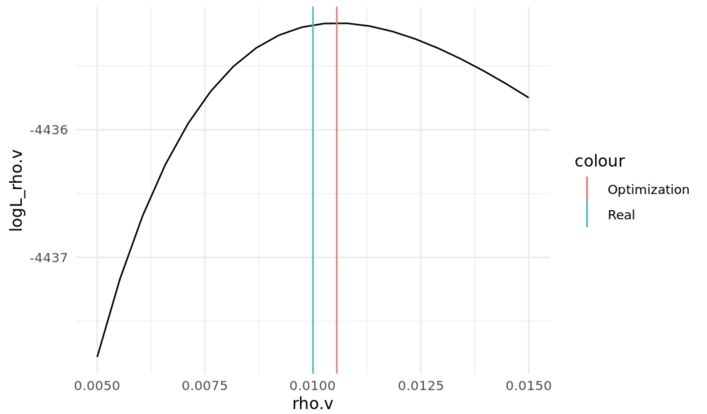
Hidden Markov model
$$[t_{3}, t_{4})$$
$$[t_{2}, t_{3})$$
$$[t_{1}, t_{2})$$
We can learn about rho and theta using a HMM:
Hidden states: discretized tree heights.
Observations: mutations.
Transition: discretized transition probability matrix.
Emission: discretized probabilities of mutation.
Initial probabilities: equal.
Use a forward algorithm to optimize the likelihood on theta and rho.
Obtain probabilities per state using a forward-backward algorithm on the optimized parameters.

Slide 15
Hidden Markov model

Slide 16
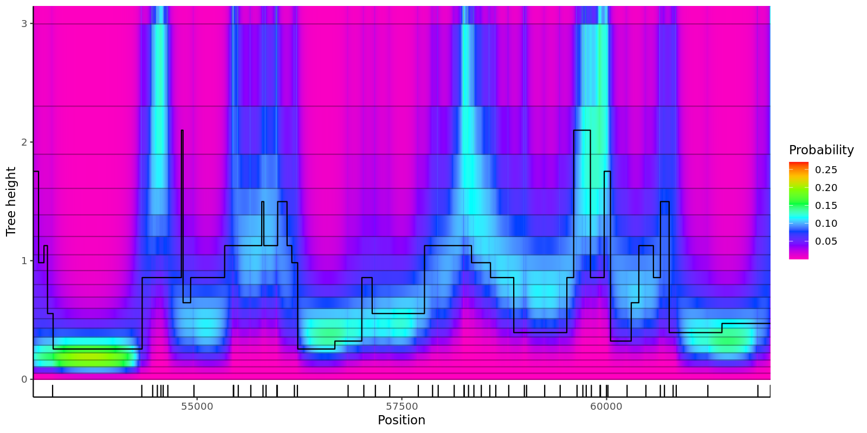
Hidden Markov model

Slide 17
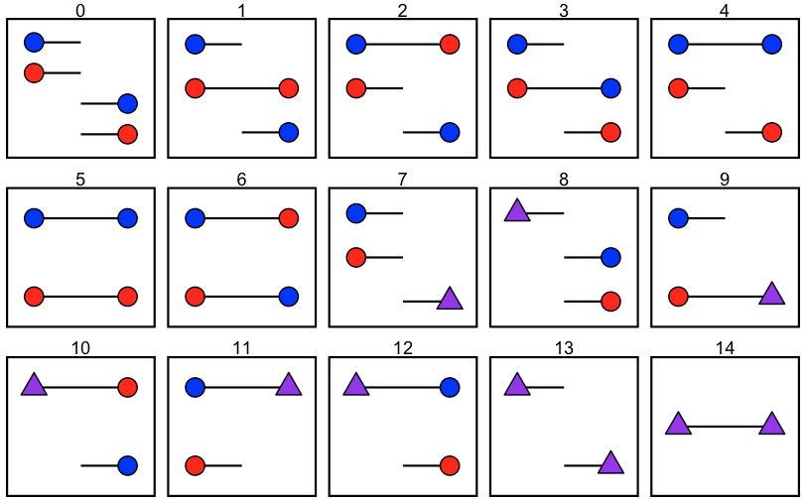
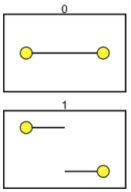
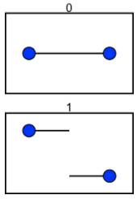
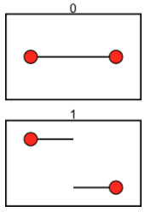
Next step
??
Moving towards ILS:
Mailund (2011).
Survey the state space.
Simplify the state space using symmetry.
Add independent Ne, rho, theta.

Slide 18
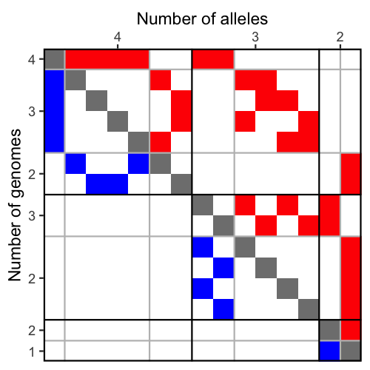
Next step
??
n=2, 15 states, 225 (44) transitions

Slide 19
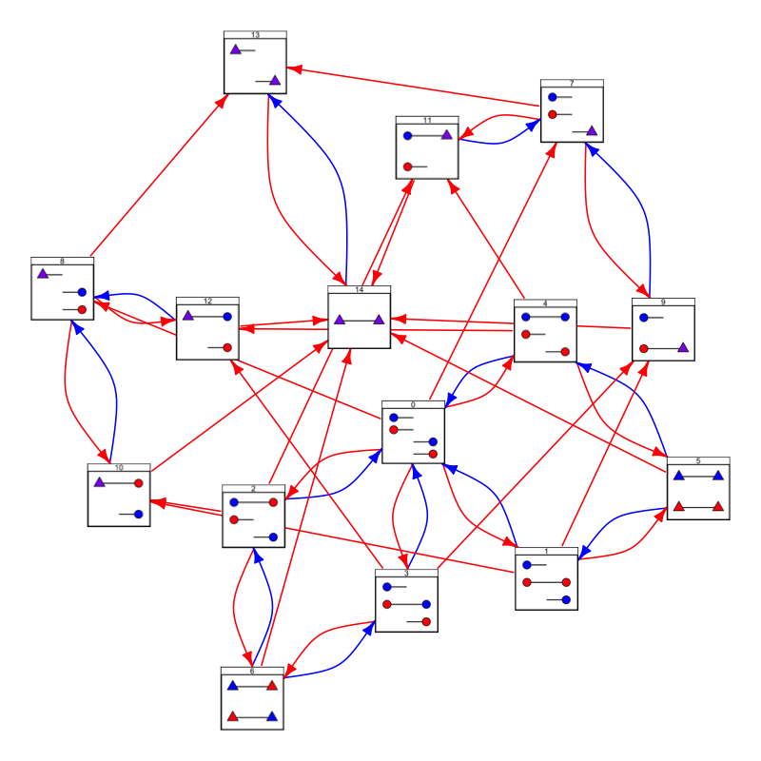
Next step
??
n=2, 15 states, 225 (44) transitions

Slide 20
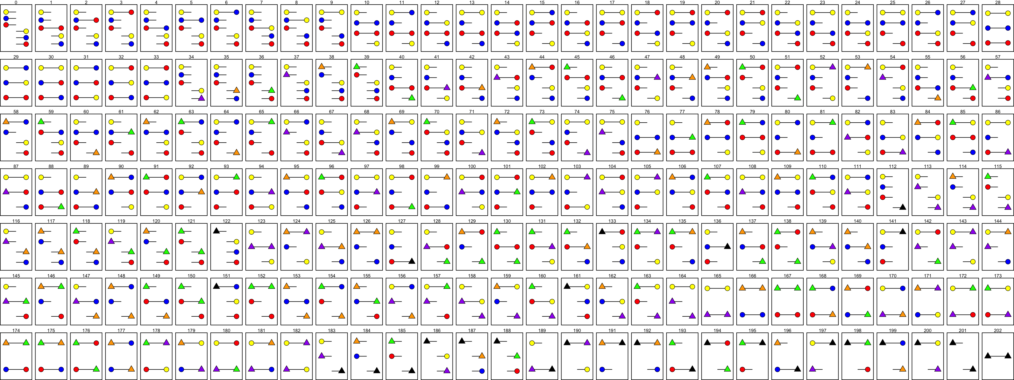
n=3 203 states 41,209 (1,118) transitions

Slide 21
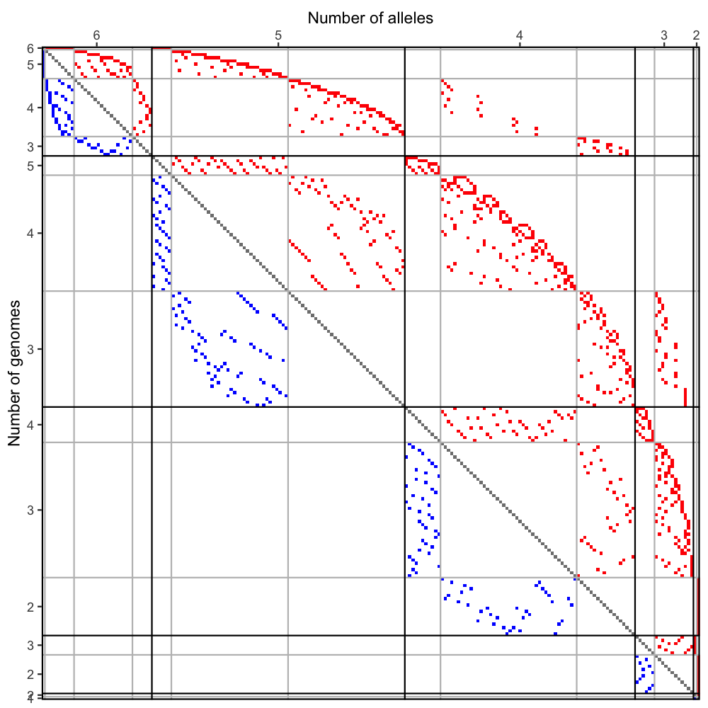
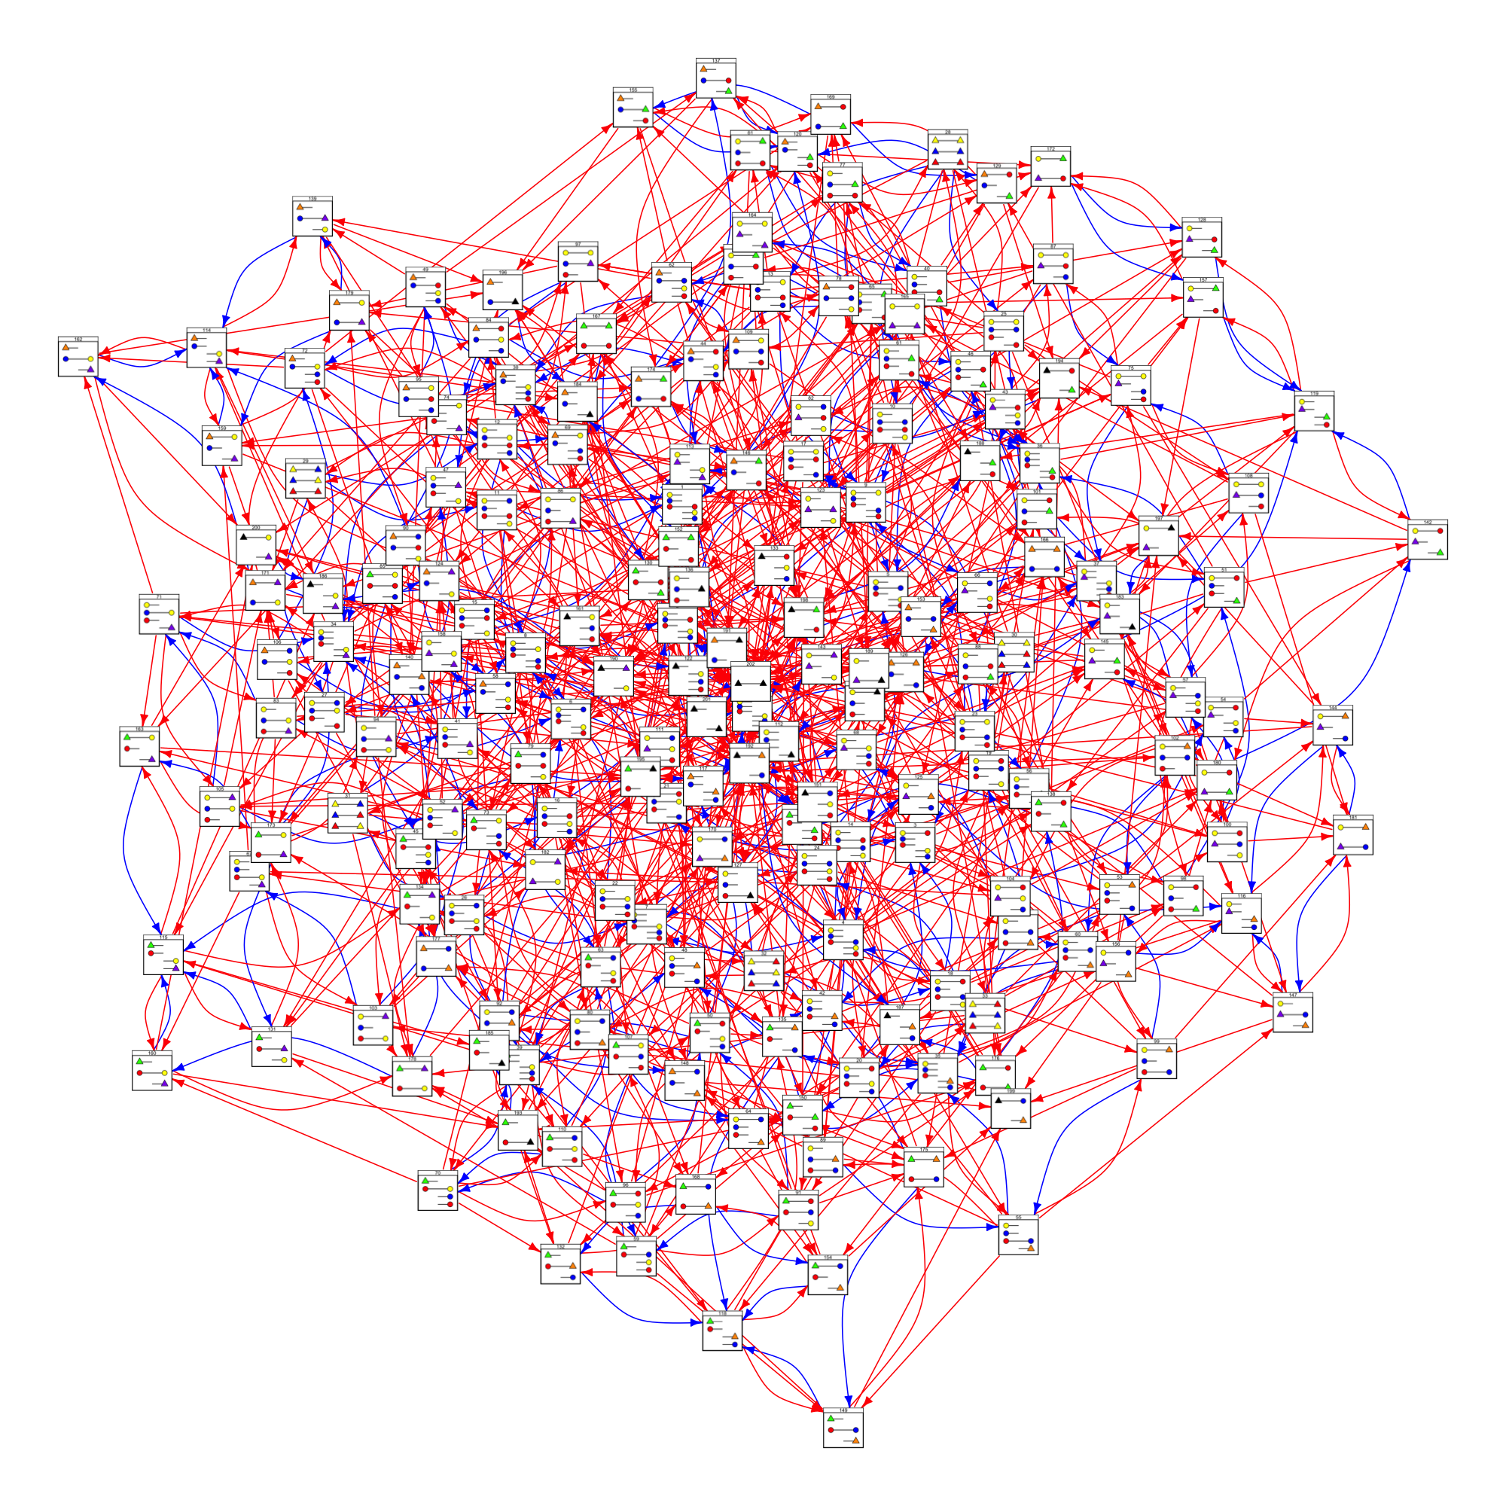
n=3 203 states 41,209 (1,118) transitions

Slide 22
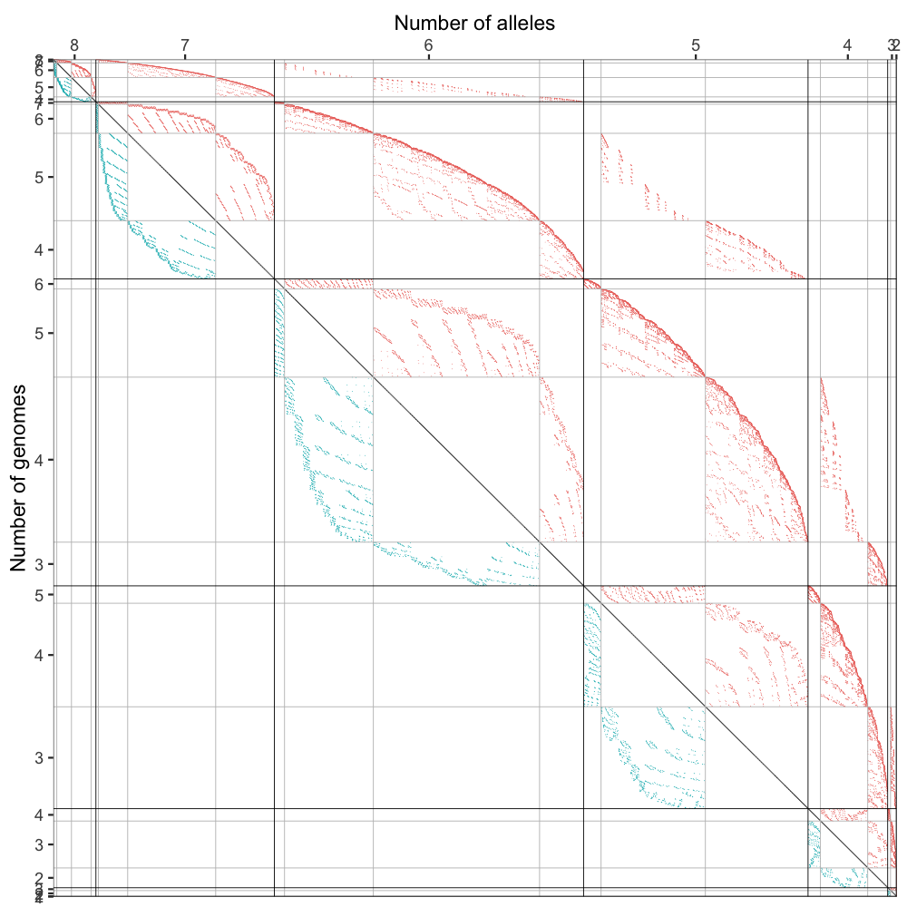
n=4 4,140 states 17,131,321 (35,446) transitions

